Slide 1
Shark Tank
File created on: 10/25/2025 7:53:37 AM

Slide 2
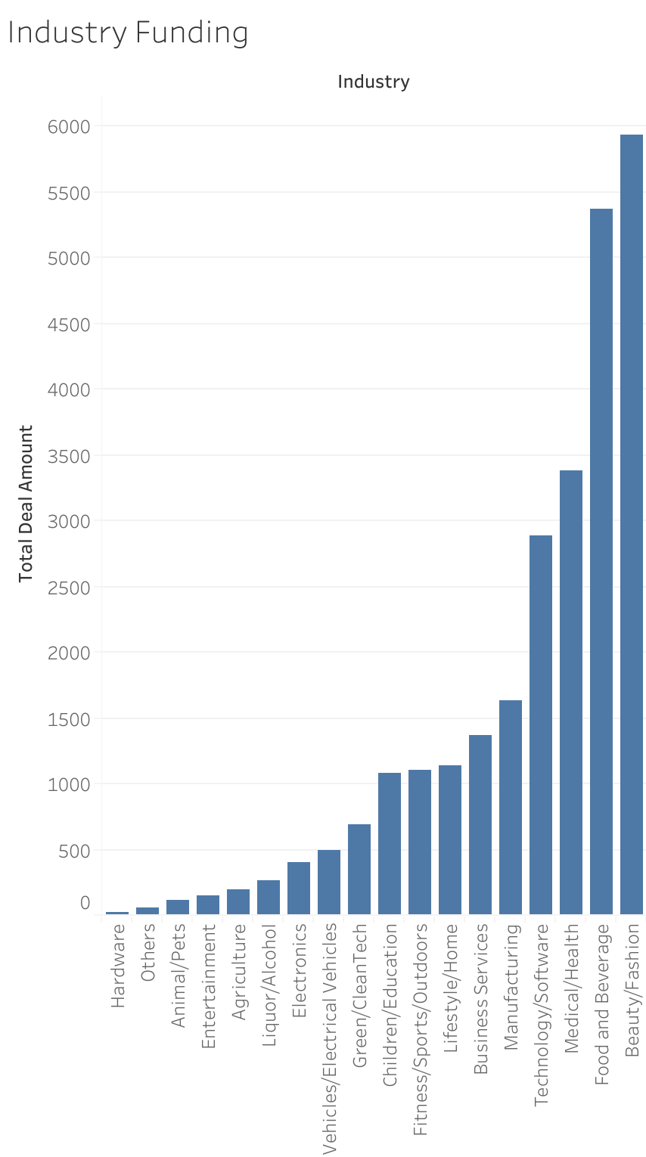

Slide 3
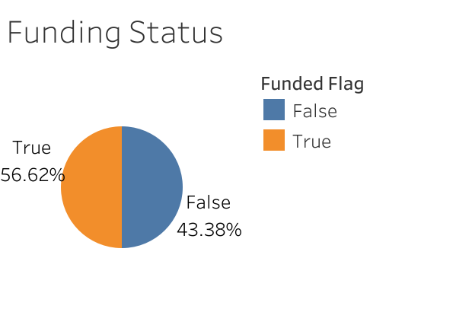

Slide 4
